Slide 1
E-Waste and Its Management

Slide 2
Contents:
Introduction and Sources
Effects of E-Waste on Environment
Effects of E-waste on Human
Methods of Disposal of E-waste
Advantage of recycling E-Waste
Conclusion

Slide 3
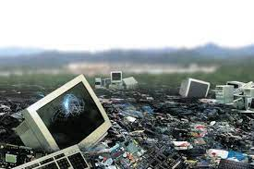
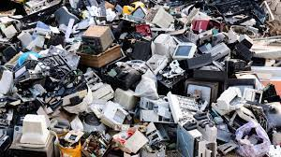
E-Waste

Slide 4
Sources Of E-Waste
Fridges, freezers and other cooling equipment.
Computers and telecommunications equipment.
Consumer electronic devices and solar panels.
TVs, monitors and screens.
LED bulbs.
Vending machines etc.

Slide 5
In 2019, the world generated a striking 53.6 Mt of e-waste, an average of 7.3 kg per capita. The global generation of e-waste grew by 9.2 Mt since 2014 and is projected to grow to 74.7 Mt by 2030 – almost doubling in only 16 years
Asia generated the highest quantity of e-waste in 2019 at 24.9 Mt, followed by the Americas (13.1 Mt) and Europe (12 Mt), while Africa and Oceania generated 2.9 Mt and 0.7 Mt, respectively.
The growing amount of e-waste is mainly fueled by higher consumption rates of EEE, short life cycles, and few repair options
(Mt: Million metric tones)
Source: (The Global E-waste Monitor 2020)

Slide 6
In 2019, the world generated a striking 53.6 Mt of e-waste, an average of 7.3 kg per capita. The global generation of e-waste grew by 9.2 Mt since 2014 and is projected to grow to 74.7 Mt by 2030 – almost doubling in only 16 years
Asia generated the highest quantity of e-waste in 2019 at 24.9 Mt, followed by the Americas (13.1 Mt) and Europe (12 Mt), while Africa and Oceania generated 2.9 Mt and 0.7 Mt, respectively.
The growing amount of e-waste is mainly fueled by higher consumption rates of EEE, short life cycles, and few repair options
(Mt: Million metric tones)
Source: (The Global E-waste Monitor 2020)

Slide 7
Causes of E-waste
After the evolution in technology during mid-70s’ begins hazardous disposal of E-waste.
Development Technological Advancement Financial obtainability Human mentality

Slide 8
Causes of E-waste
20 to 50 million metric tons of E-waste are disposed of worldwide every year.
Only 12.5% of E-waste is currently recycled.
E-waste leads to data theft hence adding to security woes.
Technology is advancing at such a fast pace that a lot of electronic devices that still work fine are considered outdated and are being replaced by newer devices.

Slide 9
Effects Of E-waste
“E-waste is often considered an overlooked epidemic, as the long-term impact of this waste is still unclear.”

Slide 10
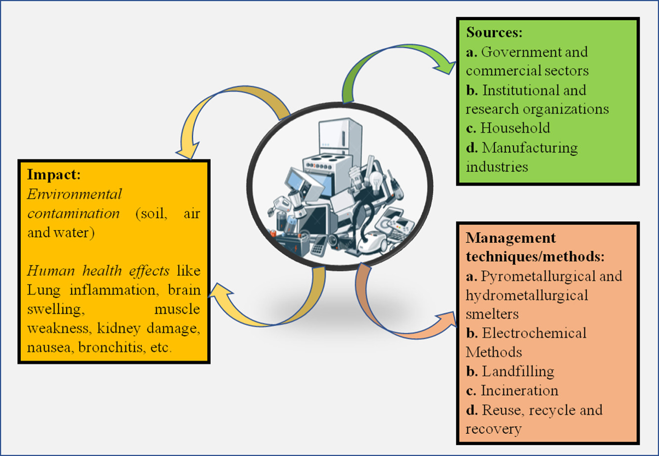

Slide 11
Effects on Environment
E-waste contains toxic materials such as lead, arsenic ,cadmium .
Acids and sludge obtained from melting computer chips, if disposed on the ground causes acidification of soil.
Releases toxic chemicals like lead, mercury barium, lithium,
Releases hydrocarbons in the atmosphere.
Climate change

Slide 12
Effects on Humans Body
Disorder in the brain, lungs, kidney, liver, blood composition. Results in physical, muscular, and neurological degeneration. DNA damage

Slide 13
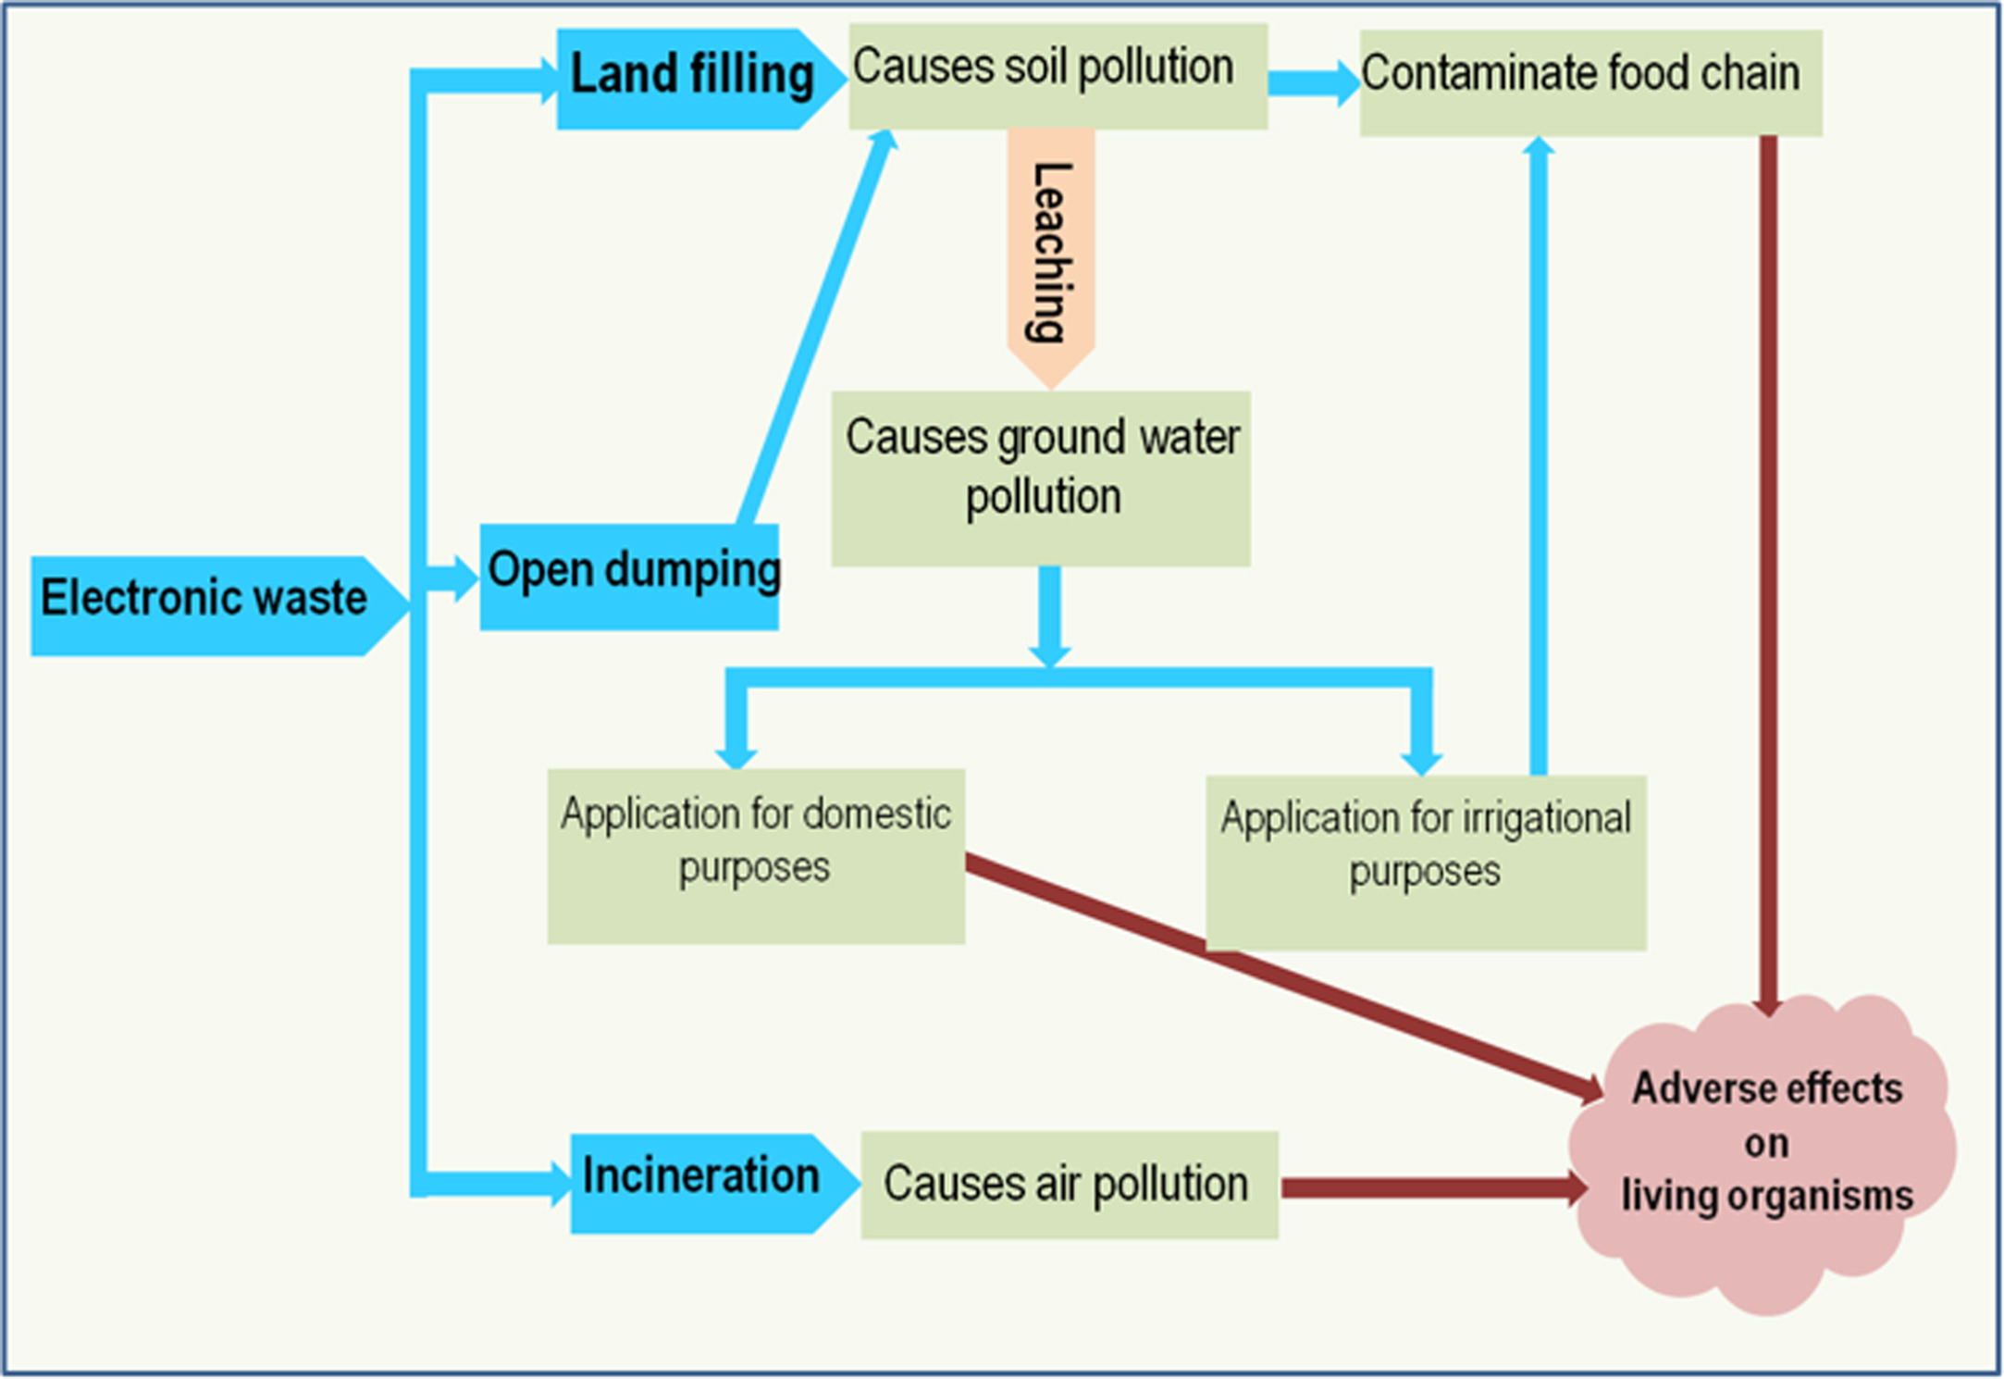

Slide 14
Thank you

